Slide 1
Using Crushed Recycled Concrete Aggregate in Ready Mix
W. Scott Brown
Concrete Operations Manager, Anchorage Sand & Gravel

Slide 2
Nomenclature:
Crushed Recycled Concrete Aggregate - RCA

Slide 3
Inspiration To Batch RCA
Denver’s Stapleton Airport Demolition
NRMCA Tour
6.5 Million Tons Crushed Concrete
Processed
Ready Mix Plant on Site
Performance Problems
Strength Gain
Severe Slump Loss
Shrinkage

Slide 4
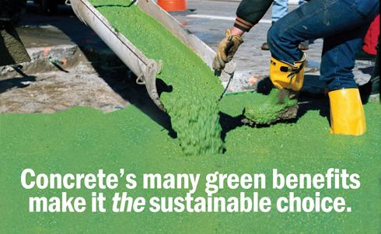
Inspiration To Batch RCA
What to do with large stockpiles of crushed concrete?
How to make concrete industry more appealing to environmentally conscious project owners?
How to make Concrete industry more appealing to community?
How to make Concrete with RCA perform in structural applications?

Slide 5
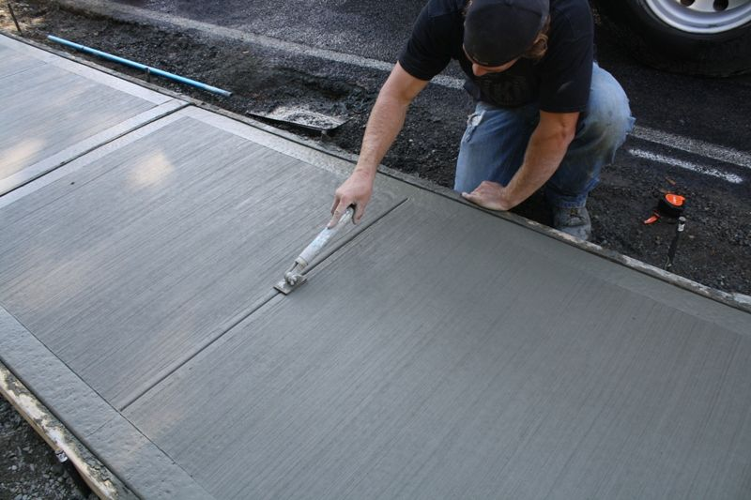
Early - R&D
Early Trial Batches
W/C, Admix, Cement Content and Agg Blends
Lots of sidewalk and patios
Same Problems
Fine Aggregate Issues
Strength Gain
Slump Loss / Acceleration
Shrinkage
Garbage

Slide 6
AS&G R&D
Mitigate the Usual Problems
REMOVE THE FINES
Willing Aggregate Producer
Cost Increase
Produced a ¾” X 3/8” Coarse Aggregate

Slide 7
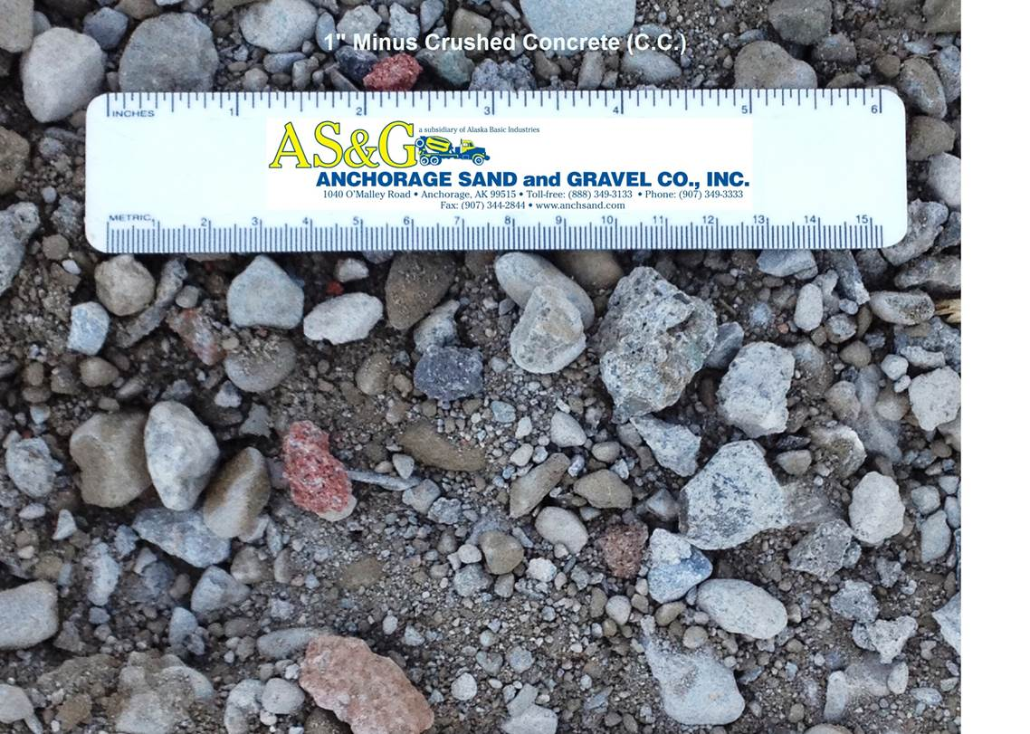
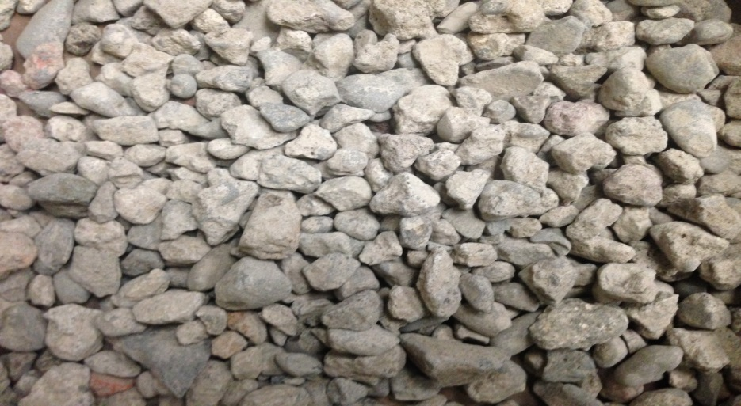
¾” Coarse RCA
1” Minus Crushed Concrete
¾” 95.4%
½” 81.2%
3/8” 72.1%
#4 51.8%
#200 5.53%
¾” RCA
¾” 96.2%
½” 51.4%
3/8” 22.2%
#4 6.7%
#200 1.35%

Slide 8
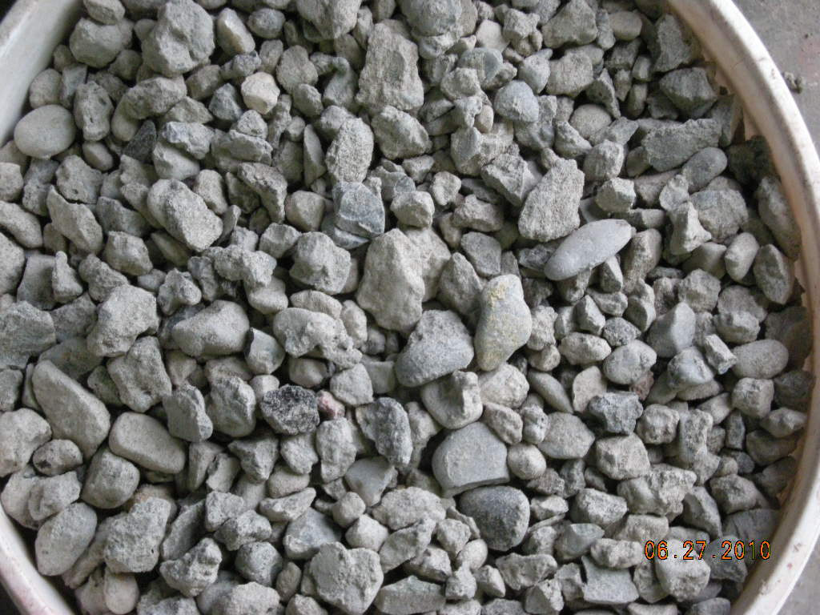
¾” Coarse RCA
Physical Properties
LA Abrasion 27
Specific Gravity 2.497
Absorption 3.3
Dilution is the Solution
20% Coarse Replacement
Maintain Slump
Pumpability
Strength
Shrinkage

Slide 9
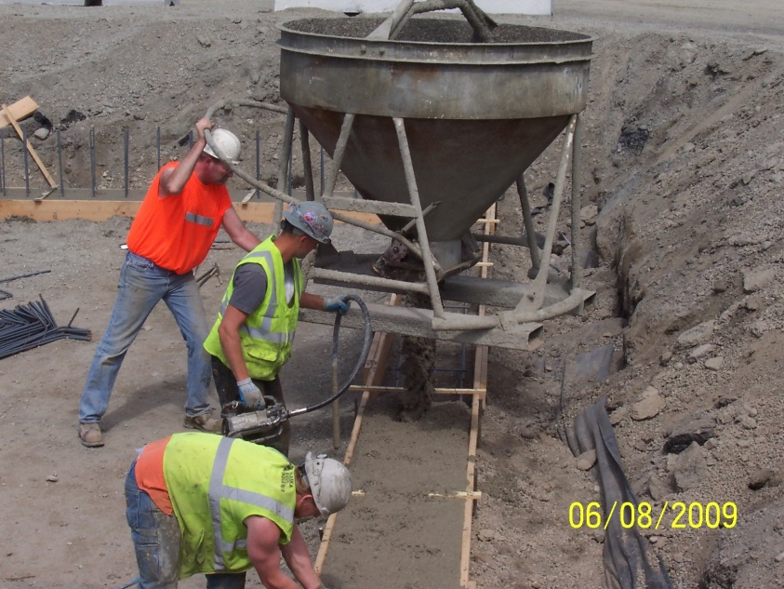
¾” Coarse RCA
100’s of yards placed in house.
Footings
SCC
Exterior and Interior SOG

Slide 10
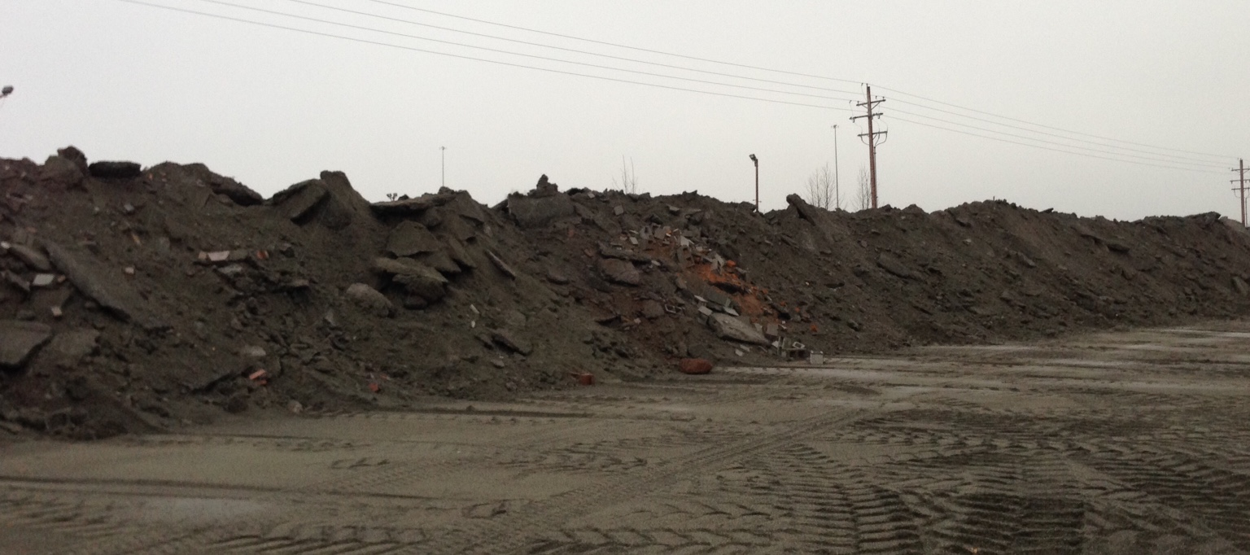
Quality Control
Limiting Returned Concrete
Reduced Contaminates
Gradations
Tech Inspections

Slide 11
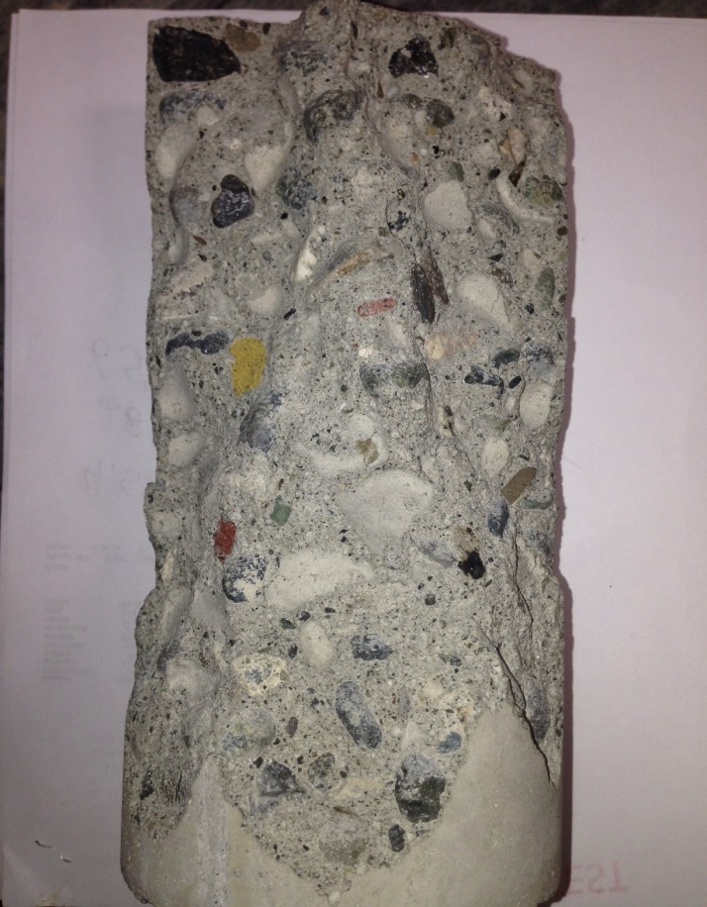
Ave 28 Day Strengths – Mixes with 20% RCA
SCC 7200psi
.45 20% ASH AIR 5800psi
.45 20% ASH NON 7300psi
.50 ¾” MRWR AIR 5490psi
.45 ¾” 6” MRWR NON 8440psi

Slide 12
Challenges
Maintaining Stockpile
Processing Costs
Agg Bin Space
Recycled Product
Variability
Constant QC Monitoring
Its Different
Guilty till proven innocent

Slide 13
Market
Environmentally Concerned homeowners
Private Companies
Government projects looking to boost their recycled content

Slide 14
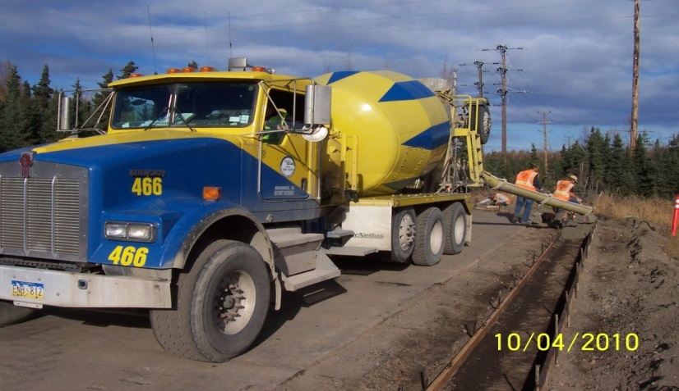
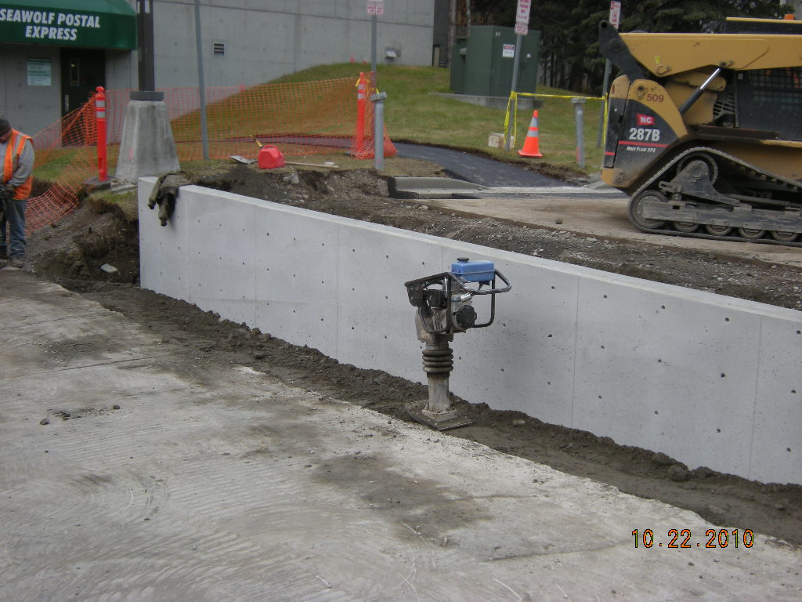
University of Alaska Anchorage
Curb and Sidewalk
SCC – Walls

Slide 15
Alaska Industrial Hardware - AIH
New Seward Hwy
Slab On Grades
Tailgated
Polished

Slide 16
JBER – F-22 ADD/ALT Weapons Shop
USACE / Bristol Environment
Remodel and New Construction
Recycled Credits
20% Flyash
Footings
Slabs

Slide 17
Towne Place Suites
Denny’s Construction
Marriot
Footings
Walls
Slabs
Shotcrete

Slide 18
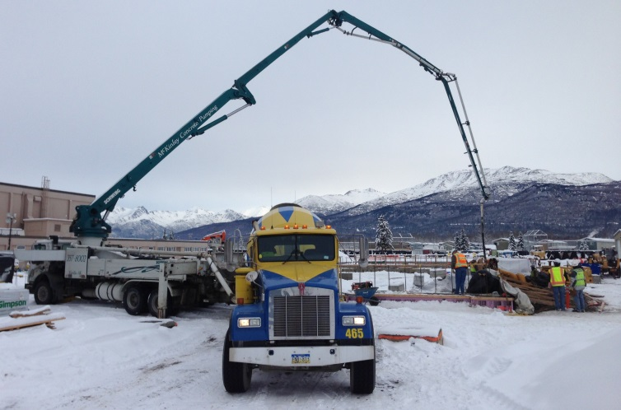
JBER – Buckner Fieldhouse
Bristol General Construction
Large Project
Footings
Walls
Interior / Exterior Slabs

Slide 19
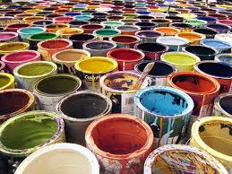
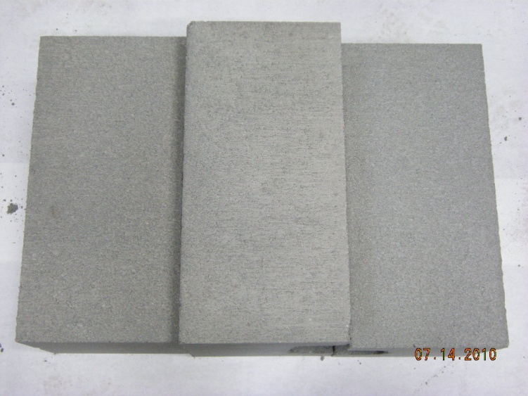
Other AS&G Products
Masonry Products
Waste Latex Paint
Which block contains Waste Latex Paint?

Slide 20
Questions:
W. Scott Brown
Operations Manager
Anchorage Sand & Gravel
scott.brown@anchsand.com

